Slide 1
Assessment Updates TNReady Window April 8 – May 3, 2019

Slide 2
Every Student Succeeds Act
Performance Levels
Level 4 = Mastered
Level 3 = On Track
Level 2 = Approaching
Level 1 = Below

Slide 3
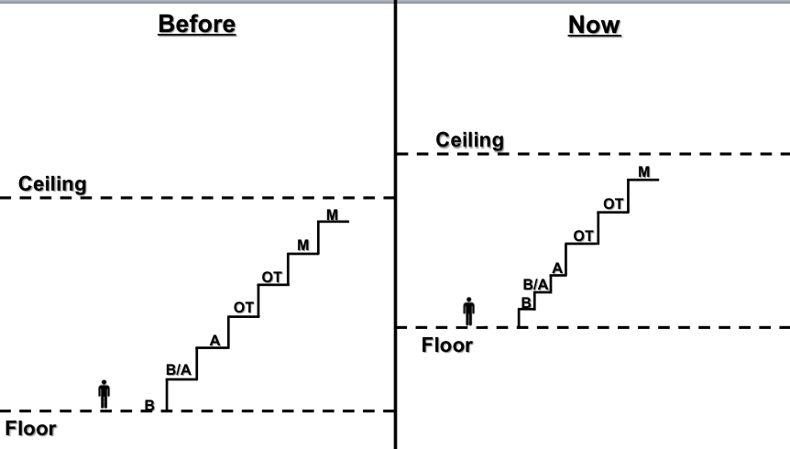
Tennessee ESSA Plan (TN Ready)
Reset of On-Track and Mastery, built on College and Career Readiness expectations
NEW
Notes:
Design Overview
Districts will be assessed on student performance in six areas measured through three pathways. The score for each area is calculated by averaging the best of absolute performance or AMO target and value-added pathways.
Performance Areas and Pathways
1. Grade 3-5 Success Rate - TCAP data, including math, English language arts, and science
2. Grade 6-8 Success Rate - TCAP data, including math, English language arts, and science
3. Grade 9-12 Success Rate - TCAP data, including math, English language arts, and science, and ACT composite/SAT equivalent (for graduating seniors using best composite score)
• For success rates, the absolute performance pathway is the number of students on track or mastered for all subjects in the applicable grade band.
• For success rates, the AMO target pathway is the target set to reduce the percent of students who are not scoring on track or mastered for all subjects in the applicable grade band.
• For success rates, the value-added pathway is the TVAAS composite in the applicable grade band.
4. Graduation rate
• The absolute performance pathway measures the percent of students in a graduation cohort who graduated within four years and one summer.
• The AMO target pathway is a target to increase the percent of students who graduate within four years and a summer.
• The value-added pathway is a student-level comparison that measures the percent of students meeting the Ready Graduate criteria. The growth expectation will be set based on the state-level performance.
5. Chronically out of school
• The absolute performance pathway measures the percent of students who are chronically out of school.
• The AMO target is a cohort-level comparison target to reduce the percent of students who are chronically out of school.
6. English Language Proficiency Assessment (WIDA ACCESS)
• The absolute performance pathway measures percent of students exiting EL status, weighted by time in ESL services.
• The AMO target is a target to increase the percent of students meeting the growth standard based on prior EL proficiency level.
• The value-added pathway is a student-level metric based on the percent of students who recently exited EL service (T1-T4) scoring on track/mastered on the TNReady ELA assessment in the current year.

Slide 4
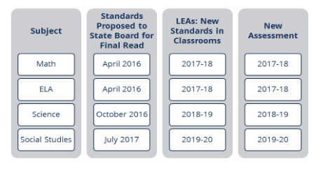
Tennessee ESSA Plan (TN Ready)
Standards and TNReady Timelines
Notes:
Design Overview
Districts will be assessed on student performance in six areas measured through three pathways. The score for each area is calculated by averaging the best of absolute performance or AMO target and value-added pathways.
Performance Areas and Pathways
1. Grade 3-5 Success Rate - TCAP data, including math, English language arts, and science
2. Grade 6-8 Success Rate - TCAP data, including math, English language arts, and science
3. Grade 9-12 Success Rate - TCAP data, including math, English language arts, and science, and ACT composite/SAT equivalent (for graduating seniors using best composite score)
• For success rates, the absolute performance pathway is the number of students on track or mastered for all subjects in the applicable grade band.
• For success rates, the AMO target pathway is the target set to reduce the percent of students who are not scoring on track or mastered for all subjects in the applicable grade band.
• For success rates, the value-added pathway is the TVAAS composite in the applicable grade band.
4. Graduation rate
• The absolute performance pathway measures the percent of students in a graduation cohort who graduated within four years and one summer.
• The AMO target pathway is a target to increase the percent of students who graduate within four years and a summer.
• The value-added pathway is a student-level comparison that measures the percent of students meeting the Ready Graduate criteria. The growth expectation will be set based on the state-level performance.
5. Chronically out of school
• The absolute performance pathway measures the percent of students who are chronically out of school.
• The AMO target is a cohort-level comparison target to reduce the percent of students who are chronically out of school.
6. English Language Proficiency Assessment (WIDA ACCESS)
• The absolute performance pathway measures percent of students exiting EL status, weighted by time in ESL services.
• The AMO target is a target to increase the percent of students meeting the growth standard based on prior EL proficiency level.
• The value-added pathway is a student-level metric based on the percent of students who recently exited EL service (T1-T4) scoring on track/mastered on the TNReady ELA assessment in the current year.

Slide 5
TN Ready
TNReady Timeline for CMCSS
Administered April 8th-18th regular administration with makeup opportunities through April 26^{th.} State window closes May 3rd.
3rd – 8th grade take paper tests for Math and ELA
3rd – 5th grade no Social Studies due to the significant changes in the standards for 2019-20
6th – 8th grade take Social Studies will be paper tests.
HS EOC are all online (Eng I and II, Alg I and II, Geometry, and US History)
Science is field tested for all grades this year, 3rd and 4th grade will be a paper test; 5th – 8th and HS Biology will be online.
Notes:
Design Overview
Districts will be assessed on student performance in six areas measured through three pathways. The score for each area is calculated by averaging the best of absolute performance or AMO target and value-added pathways.
Performance Areas and Pathways
1. Grade 3-5 Success Rate - TCAP data, including math, English language arts, and science
2. Grade 6-8 Success Rate - TCAP data, including math, English language arts, and science
3. Grade 9-12 Success Rate - TCAP data, including math, English language arts, and science, and ACT composite/SAT equivalent (for graduating seniors using best composite score)
• For success rates, the absolute performance pathway is the number of students on track or mastered for all subjects in the applicable grade band.
• For success rates, the AMO target pathway is the target set to reduce the percent of students who are not scoring on track or mastered for all subjects in the applicable grade band.
• For success rates, the value-added pathway is the TVAAS composite in the applicable grade band.
4. Graduation rate
• The absolute performance pathway measures the percent of students in a graduation cohort who graduated within four years and one summer.
• The AMO target pathway is a target to increase the percent of students who graduate within four years and a summer.
• The value-added pathway is a student-level comparison that measures the percent of students meeting the Ready Graduate criteria. The growth expectation will be set based on the state-level performance.
5. Chronically out of school
• The absolute performance pathway measures the percent of students who are chronically out of school.
• The AMO target is a cohort-level comparison target to reduce the percent of students who are chronically out of school.
6. English Language Proficiency Assessment (WIDA ACCESS)
• The absolute performance pathway measures percent of students exiting EL status, weighted by time in ESL services.
• The AMO target is a target to increase the percent of students meeting the growth standard based on prior EL proficiency level.
• The value-added pathway is a student-level metric based on the percent of students who recently exited EL service (T1-T4) scoring on track/mastered on the TNReady ELA assessment in the current year.

Slide 6
Inclusion of TN Ready on student report cards
Policy: INS-A023
Effective April 17, 2015 in alignment with HB 36 – SB 285 Amendment (005744), Clarksville Montgomery County School System will not include students’ TCAP scores in their final spring semester grades if the TCAP scores are not received by the district at least five instructional days before the end of the academic year.
Impact on student’s grade
2018-19 (and in all subsequent years): 15–25 percent of final grade (district decision within this range) CMCSS has selected 15%
Notes:
For 2017, the State has reported it will provide the raw scores the week of May 22. For inclusion in the report card grades would need to arrive by May 12th, the day CMCSS is shipping the materials back.

Slide 7
Questions Assessment Updates

