Slide 1
Addressing Student Capacity
Operational Briefing
October 2018

Slide 2
Balancing Enrollment and Capacity

Slide 3
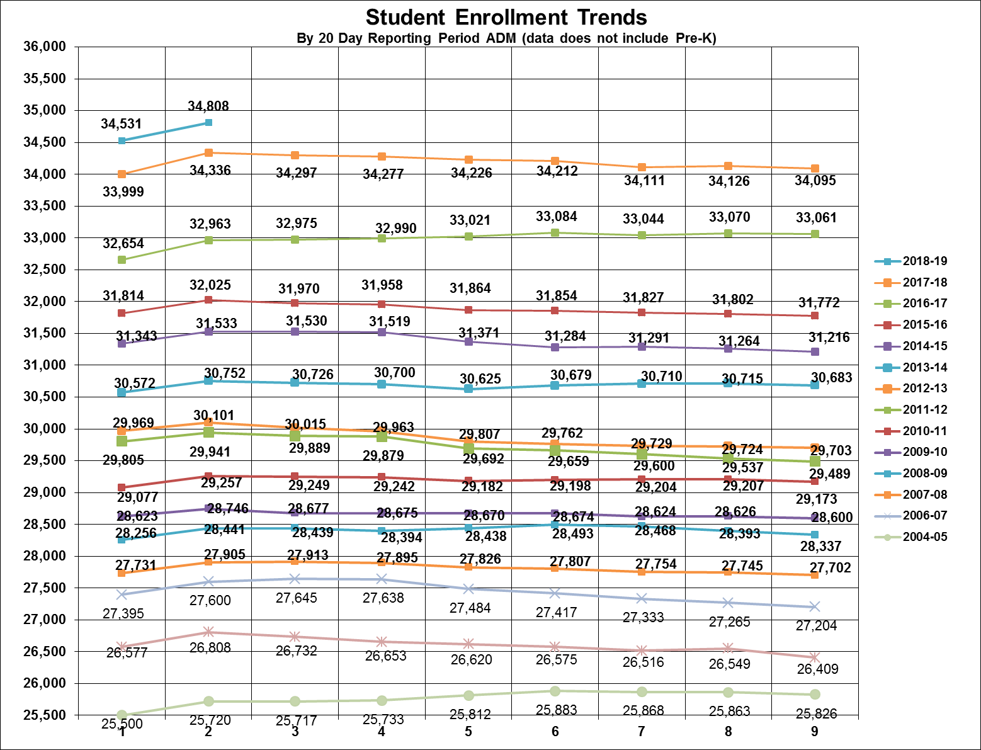
Annual Growth Trends
491 Increase
w/ Pre-K
Does not include Pre-K
Notes:
Will update with correct 20th and 40th day numbers for this year when we receive them from Richard

Slide 4
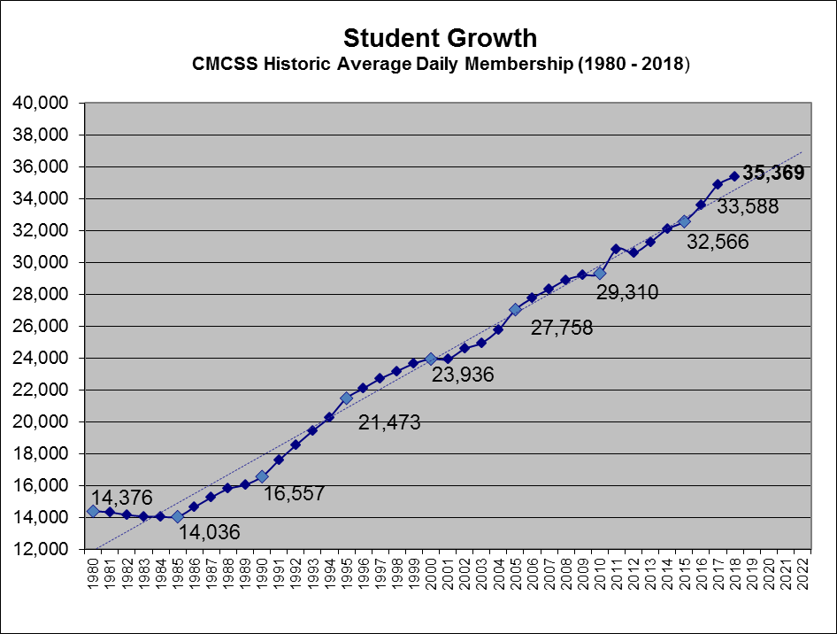
Notes:
Will need to update when 40th day info comes in.

Slide 5
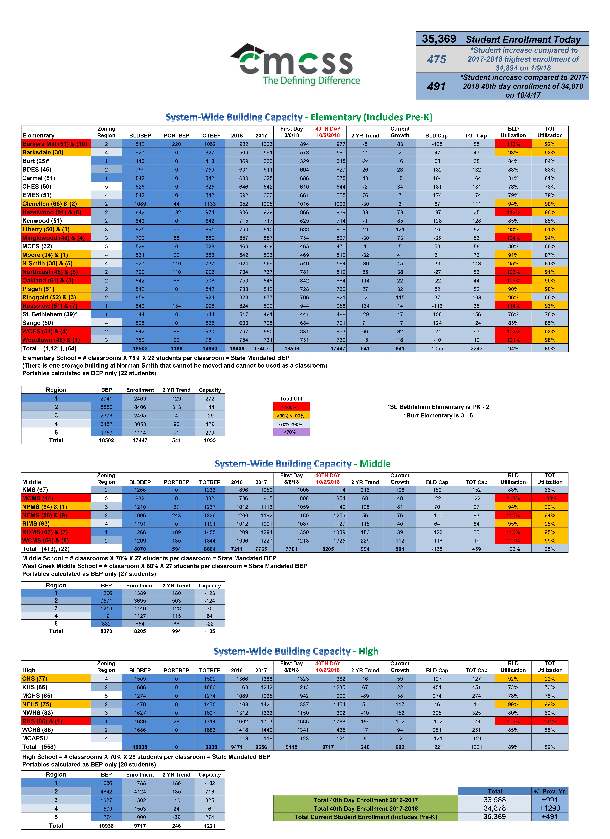
Capacity Analysis
Elementary BEP Capacity
BEP Capacity with portables
Enrollment
Growth trends
95% Utilization
8 Schools > 100%
Middle School BEP Capacity
BEP Capacity with portables
Enrollment
Growth trends
102% Utilization
4 Schools > 100%
High School BEP Capacity
Enrollment
Growth trends
91% Utilization
1 Schools > 100%
Notes:
Elementary yearly growth trend of 12 classrooms
Middle yearly growth trend of 18.5 classrooms
High yearly growth trend of 11 classrooms

Slide 6
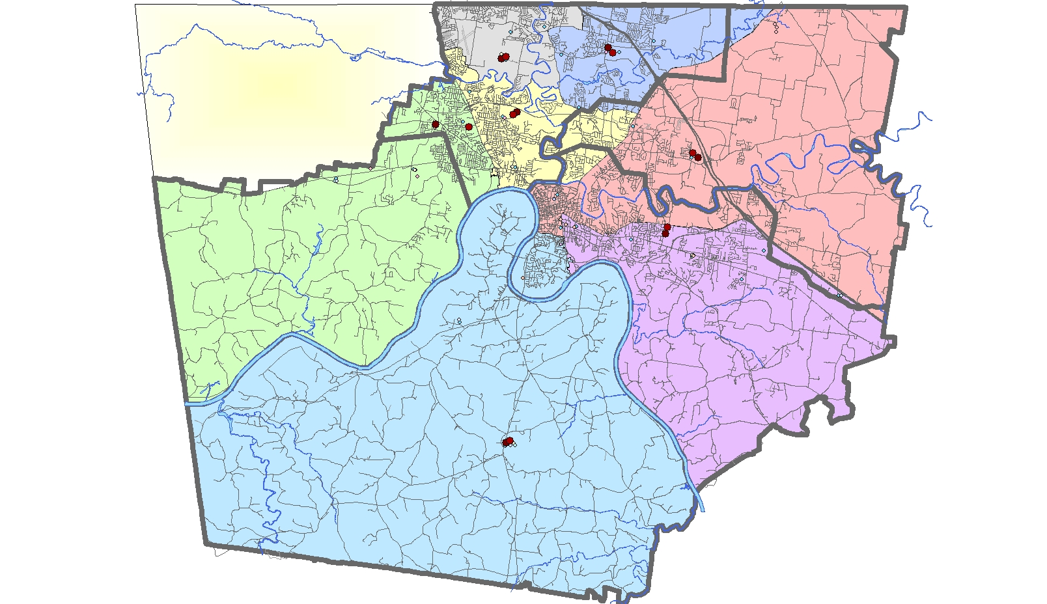
2018-2019 Middle/High School Capacities
West Creek
Northeast
M 110%/99%
H 85%
M 115%/94%
H 99%
2
1
Rossview
Kenwood
M 110%/95%
H 106%/104%
M 88%
H 73%
New Prov./NWHS
3
M 94%/92%
H 80%
4
Richview/CHS
M 95%
H 92%
5
M. Central
M 103%/
H 78%
Capacity Status – Enrollment
Greater than 100%
90% - 100%
70% - 90%
Less than 70%
20
Notes:
Once the addition are completed and in use
NEMS will be 97%/86%
NEHS will be 85%

Slide 7
2018-2019 Middle/High School Capacities After Additions
West Creek
Northeast
M 110%/99%
H 85%
M 98%/82%
H 85%
2
1
Rossview
Kenwood
M 110%/95%
H 106%/104%
M 88%
H 73%
New Prov./NWHS
3
M 94%/92%
H 80%
4
Richview/CHS
M 95%
H 92%
5
M. Central
M 103%/
H 78%
Capacity Status – Enrollment
Greater than 100%
90% - 100%
70% - 90%
Less than 70%
20
Notes:
Once the addition are completed and in use
NEMS will be 97%/86%
NEHS will be 85%

Slide 8
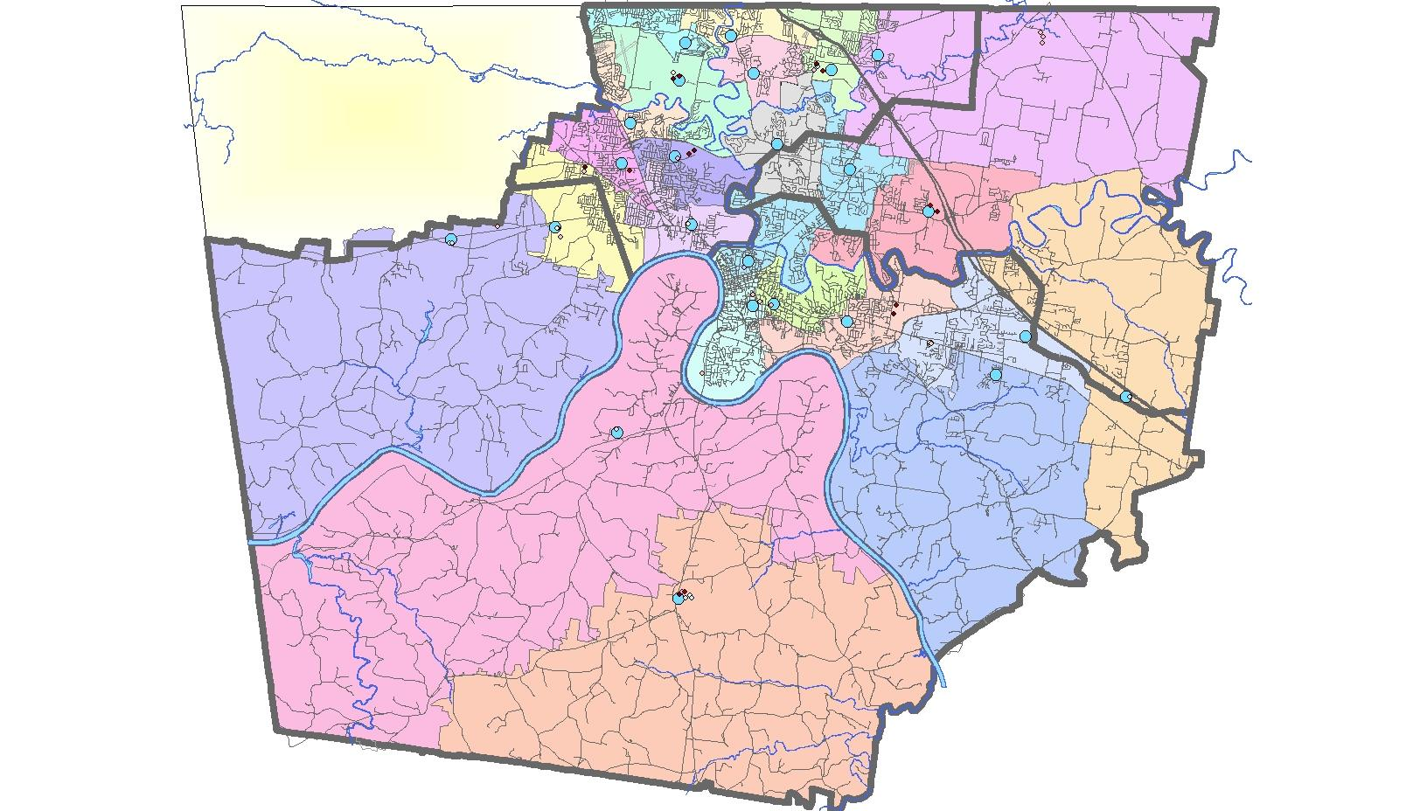
2018-2019 Elementary School Capacities
Barkers Mill
Hazelwood
Northeast
103%/91%
116%/ 92%
112%/96%
2
West Creek
Pisgah
102%/93%
90%
Oakland
103%/95%
Ringgold
1
96%/89%
Glenellen
Minglewood
94%/90%
104%/94%
Kenwood
85%
St Bethlehem K-2
Burt 3-5
Liberty
76%/84%
Rossview
98% / 91%
Byrns Darden
114%/96%
83%
3
Moore
Carmel
91%/87%
81%
Sango
Woodlawn
Norman Smith
Barksdale
85%
101%/98%
93%
95%/81%
4
5
East Montgomery
Cumberland Heights
79%
78%
Montgomery Central
Capacity Status – Enrollment
89%
Greater than 100%
90% - 100%
70% - 90%
Less than 70%
20
Notes:
Once the addition are completed
Barkers Mill will be 94%/81%
Minglewood will be 83%/78%

Slide 9
2018-2019 Elementary School Capacities After Additions
Barkers Mill
Hazelwood
Northeast
103%/91%
86%/ 72%
112%/96%
2
West Creek
Pisgah
102%/93%
90%
Oakland
103%/95%
Ringgold
1
96%/89%
Glenellen
Minglewood
94%/90%
84%/77%
Kenwood
85%
St Bethlehem K-2
Burt 3-5
Liberty
76%/84%
Rossview
98% / 91%
Byrns Darden
114%/96%
83%
3
Moore
Carmel
91%/87%
81%
Sango
Woodlawn
Norman Smith
Barksdale
85%
101%/98%
93%
95%/81%
4
5
East Montgomery
Cumberland Heights
79%
78%
Montgomery Central
89%
Capacity Status – Enrollment
Greater than 100%
90% - 100%
70% - 90%
Less than 70%
20
Notes:
Once the addition are completed
Barkers Mill will be 94%/81%
Minglewood will be 83%/78%

Slide 10
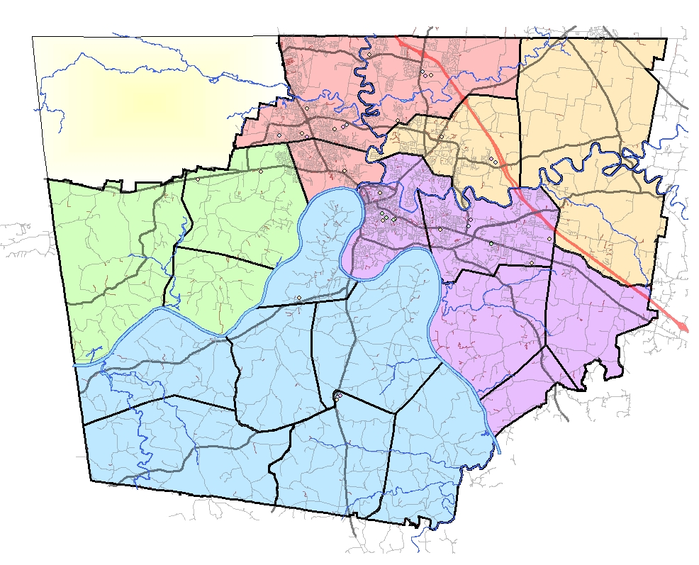
CMCSS Portable Distribution By Zoning Regions
Region 2
Region 1
Region 3
Region 4
Region 5
Portables in District
Total = 83
Square Footage = 85,201
Number of Seats = 1,974
Notes:
80% of all portables are between Zoning Region 1&2

Slide 11
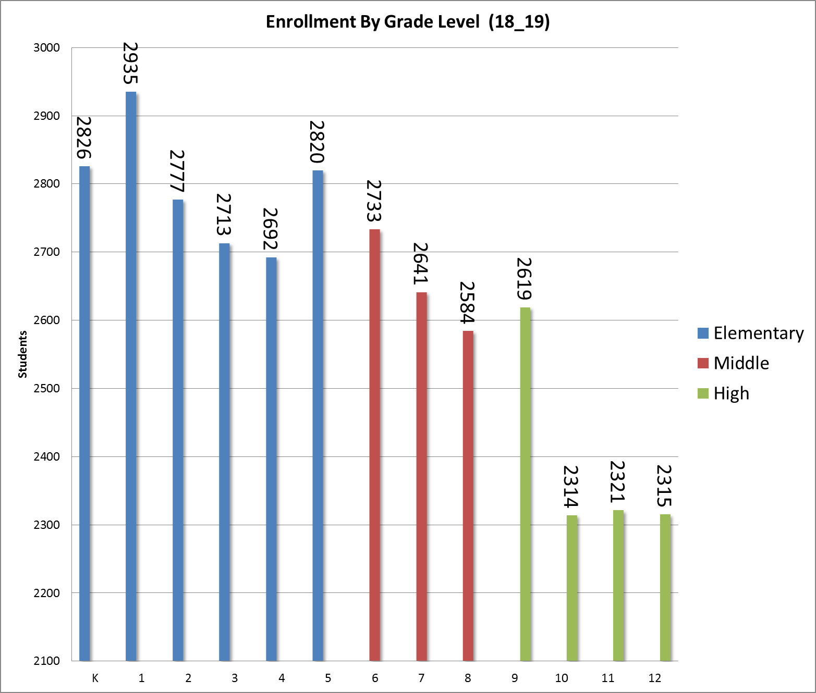
HS Capacity per GL= 2735 (Current)
MS Capacity per GL= 2690 (Current)
Notes:
472 additional students in current K-2 that will put us 18 classrooms above current middle school capacity
314 additional students in current K-3 that will put us 11 classrooms above current high school capacity

Slide 12
Facilities Planning and Construction

Slide 13
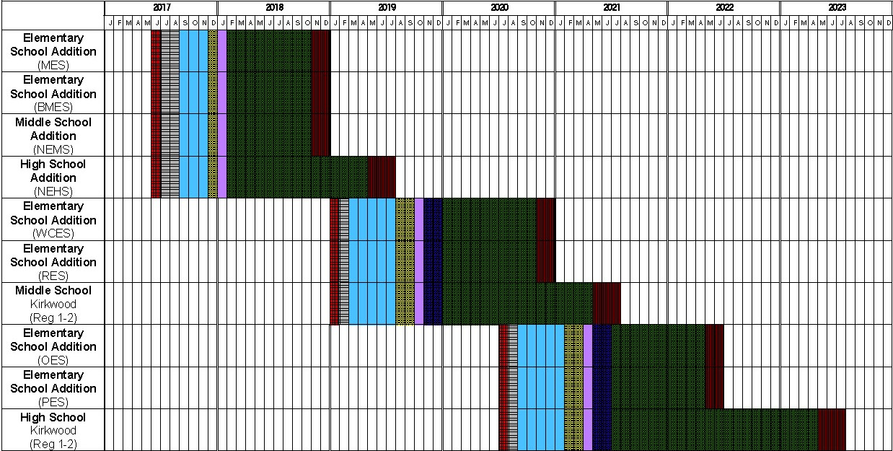
2017-2021 Building Program
Phase 1
Notes:
This is the CMCSS Building Program
Budget Committee and CMCSS came up with approved by a resolution by County Commissioners
4 Projects were bid on Jan 2018 for $14,570,746 million dollars

Slide 14
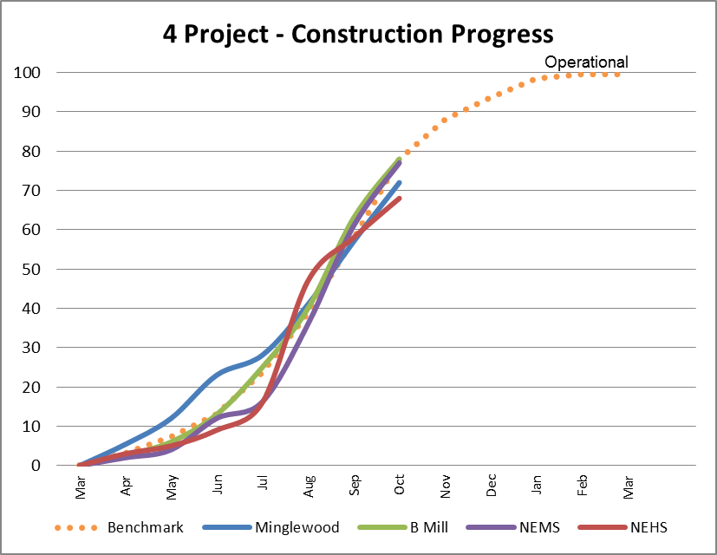
Notes:
Started in March proceeding on schedule as of September.
Approximately 60 % complete and on benchmark as of today.
They are approaching 80% complete with minor impacts do to weather

Slide 15
Timeline Design & Construction
Notes:
In the last stages of Construction
making preparation for turn over in Nov + Dec timeframe with being operational in Jan 2019

Slide 16
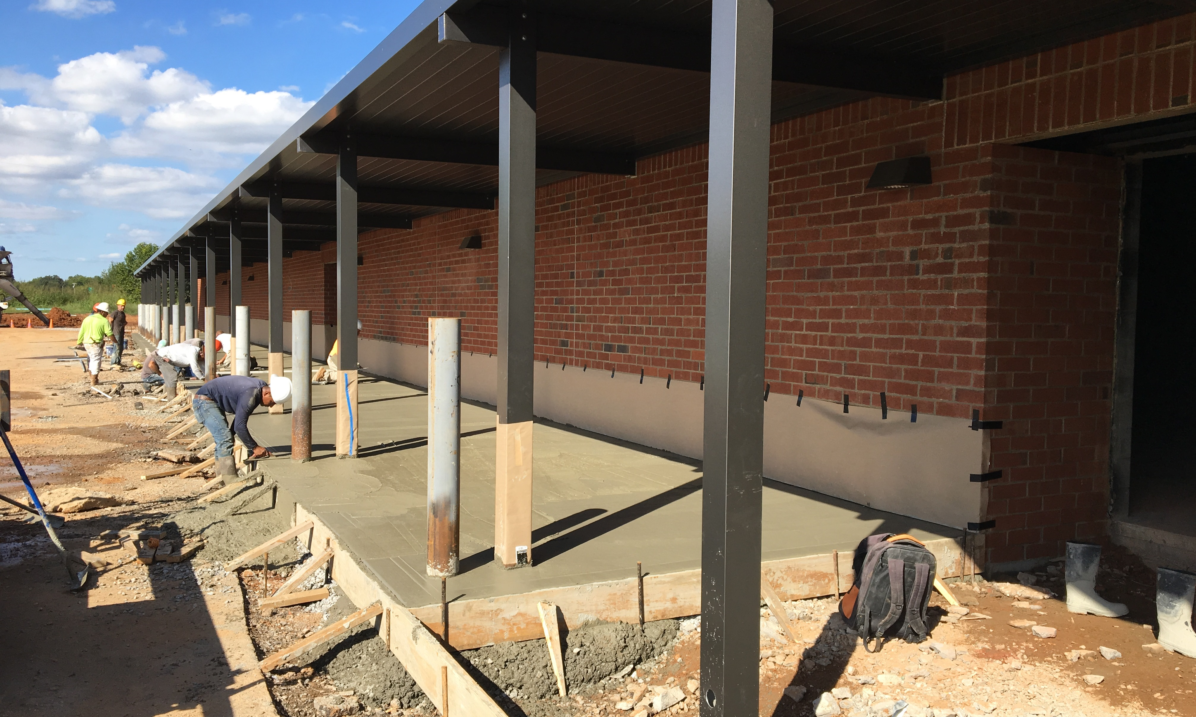
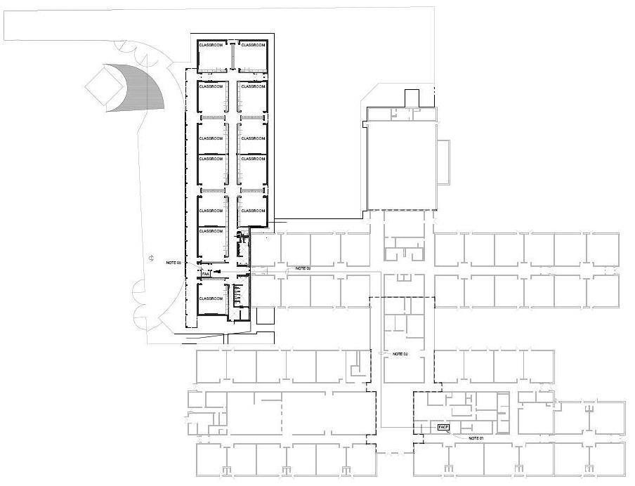
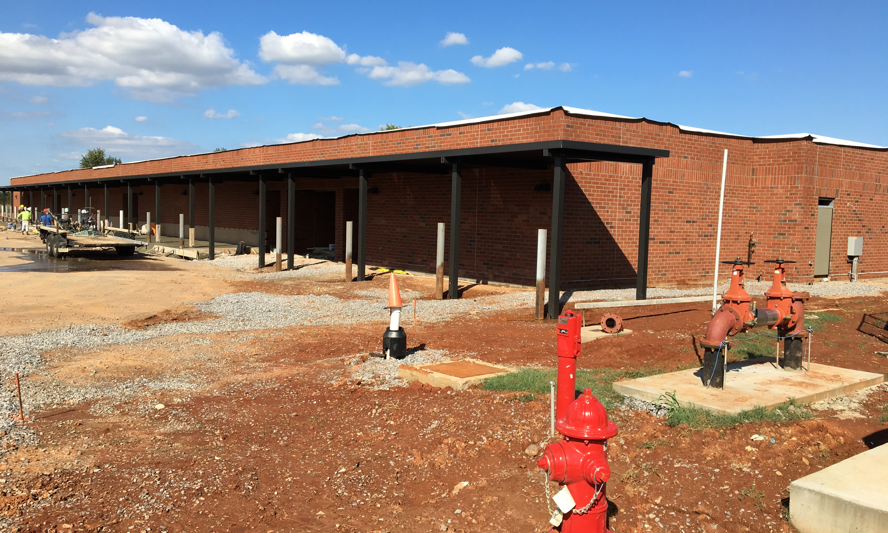
Minglewood Elementary
Description:
16,194 Square foot addition with 12 classrooms, two restrooms, mechanical, technology, and transportation site modifications
BEP: 792 → 990
Financial Summary: | BID
Building Construction | $2,917,594
Equipment/Tech./Furniture/Oth | $200,000
 | $3,117,594

Slide 17
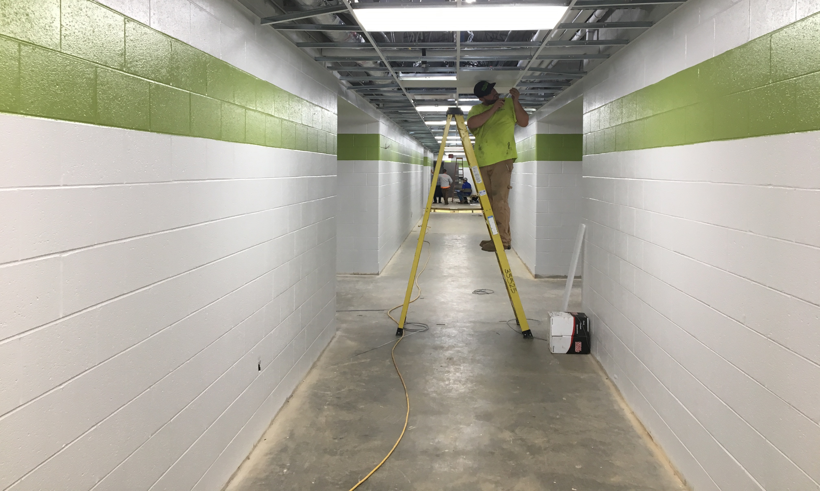
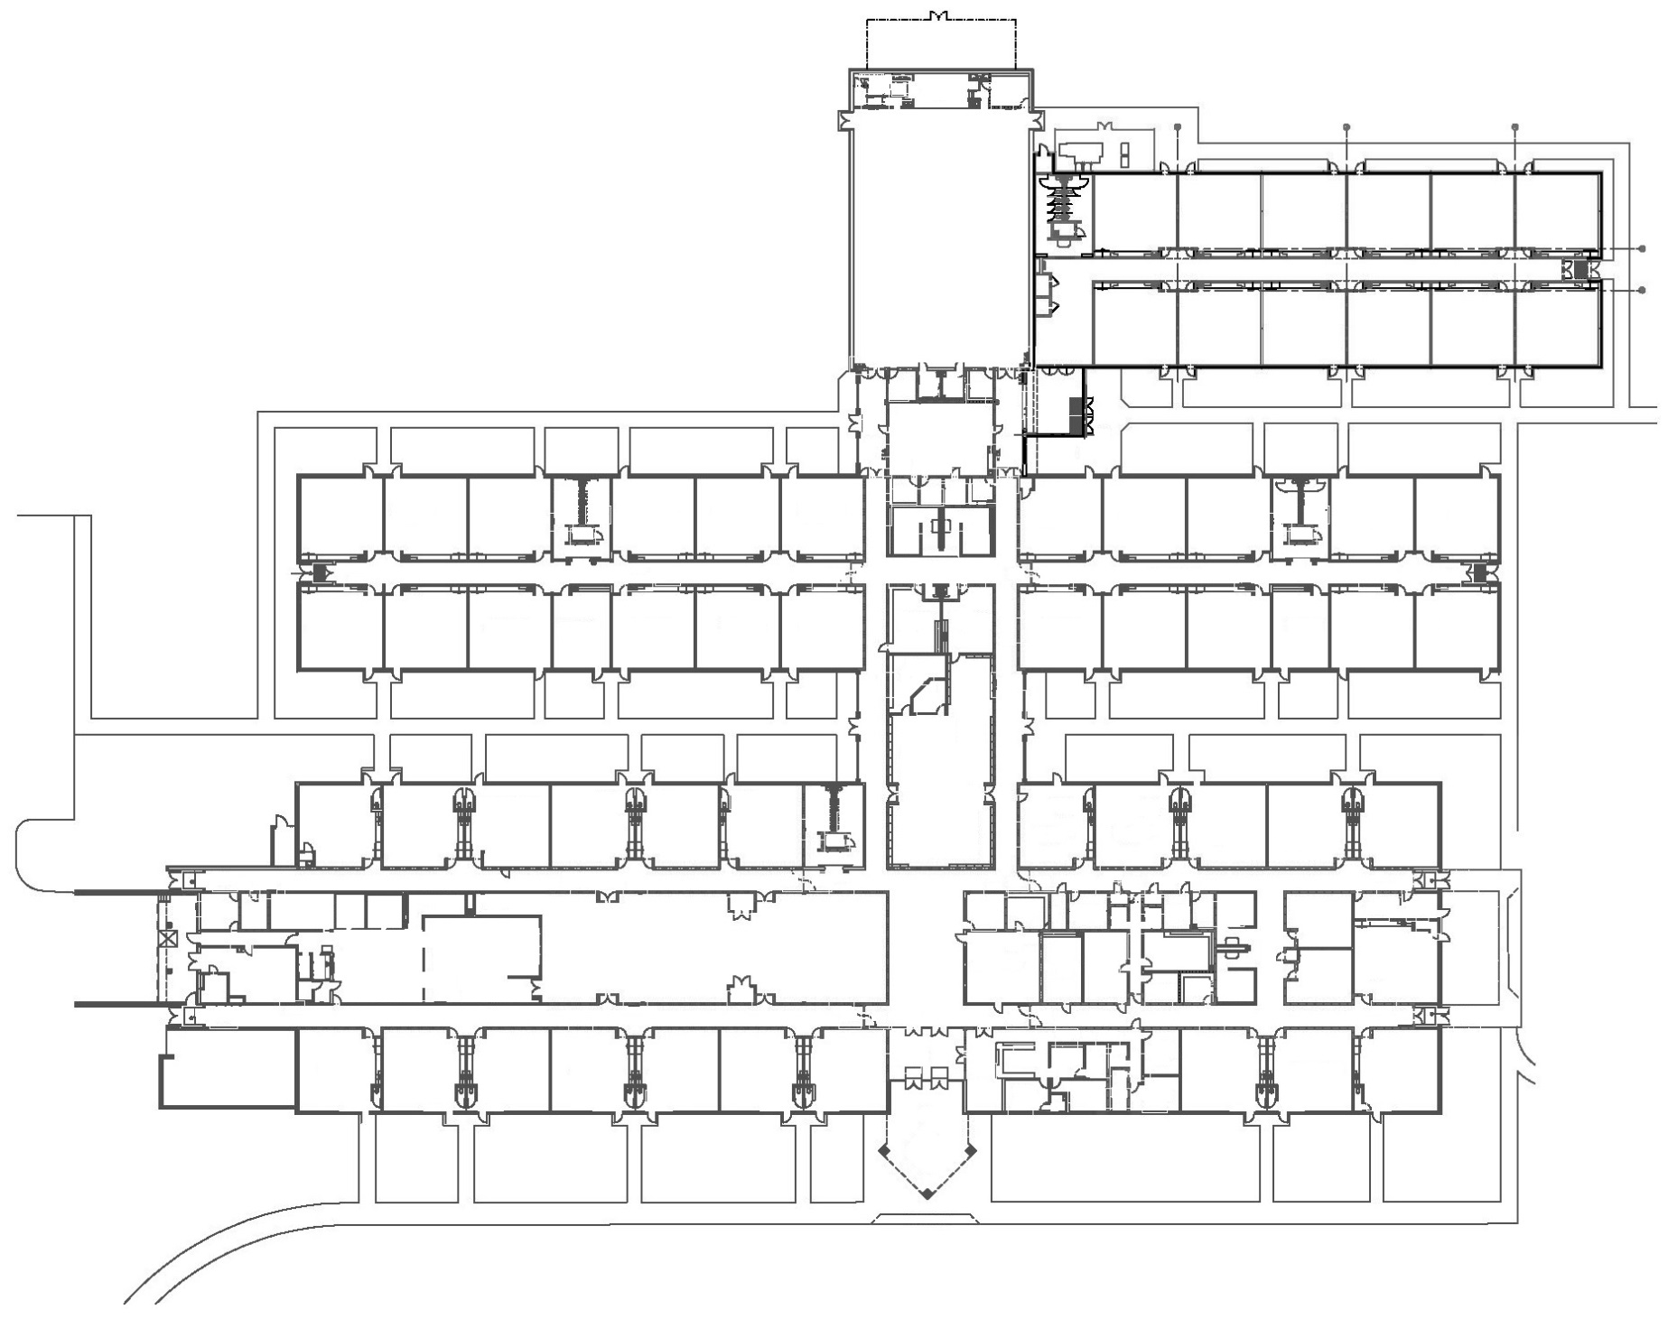
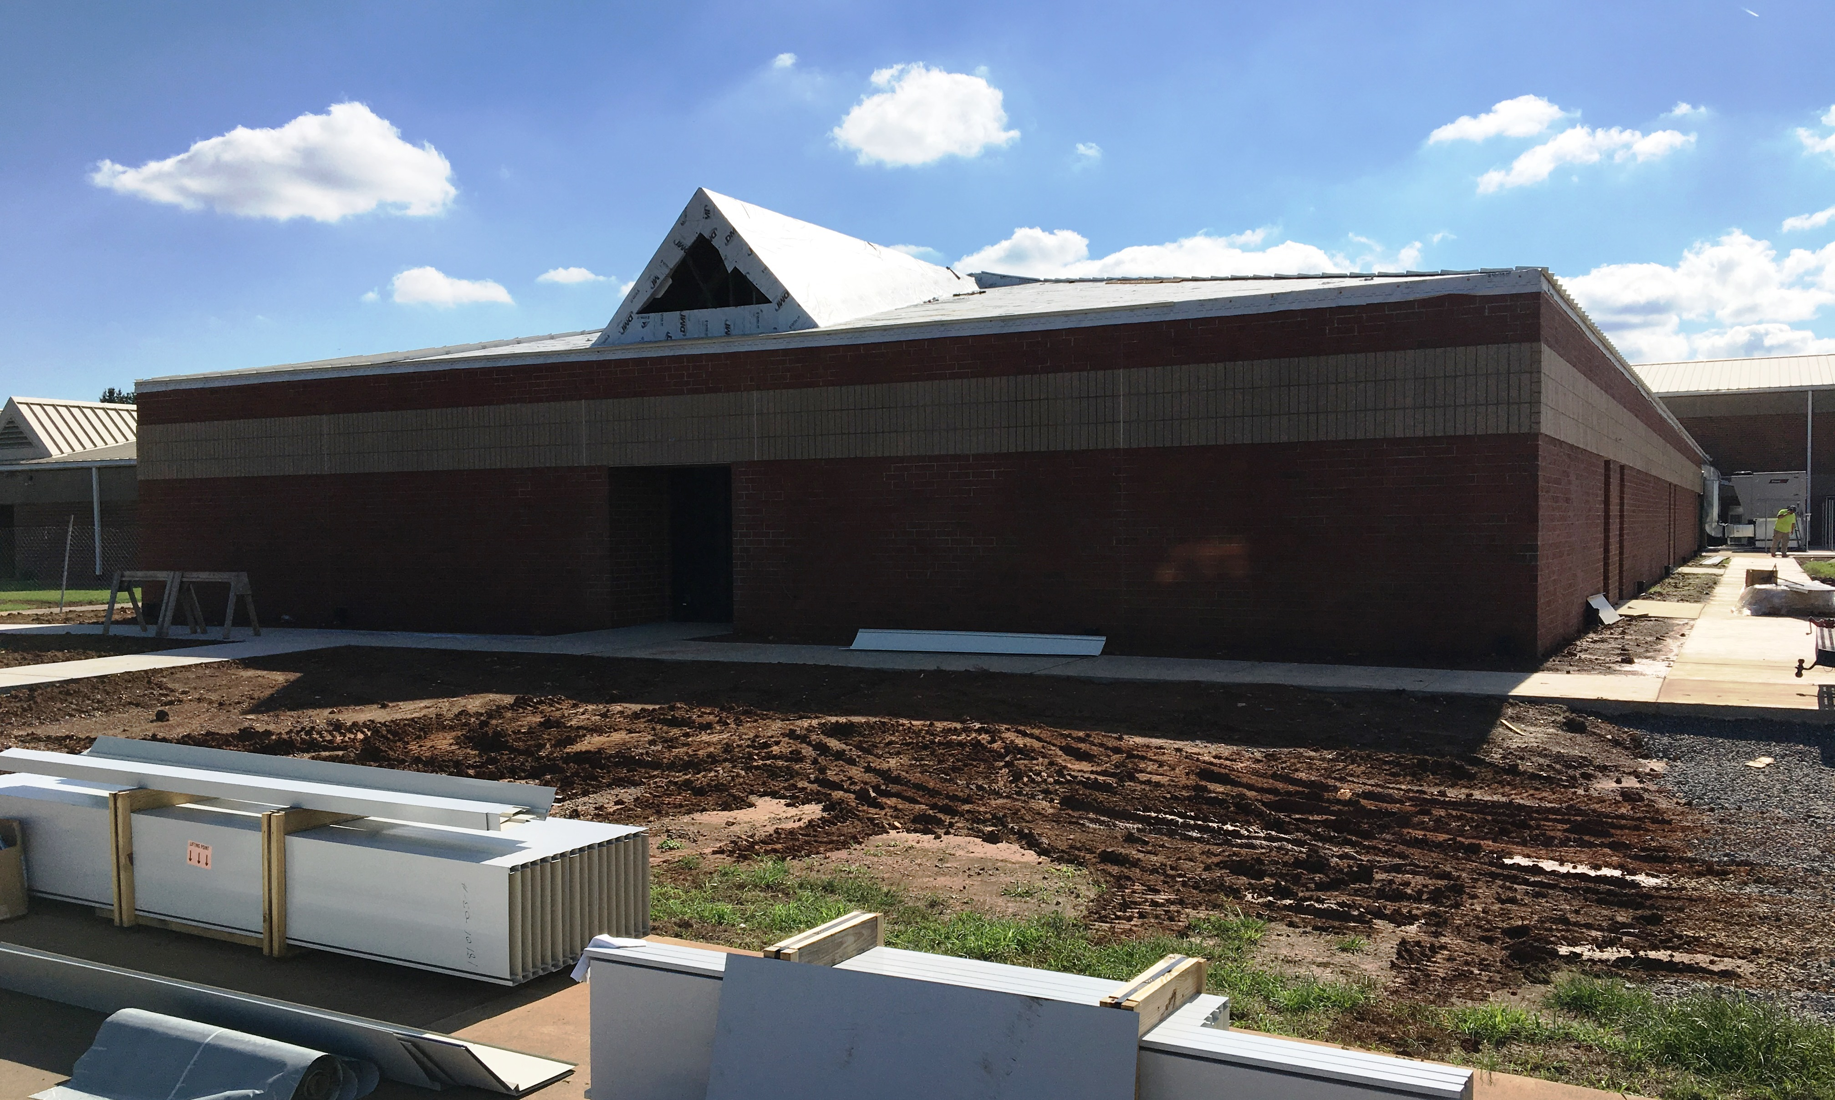
Barkers Mill Elementary
Description:
14,886 Square foot addition with 12 Classrooms, Two Restrooms, mechanical, technology, connector, and minor site modifications
BEP: 842 → 1,140
Financial Summary: | BID
Building Construction | $2,604,073
Equipment/Tech./Furniture/Oth | $200,000
 | $2,804,073

Slide 18
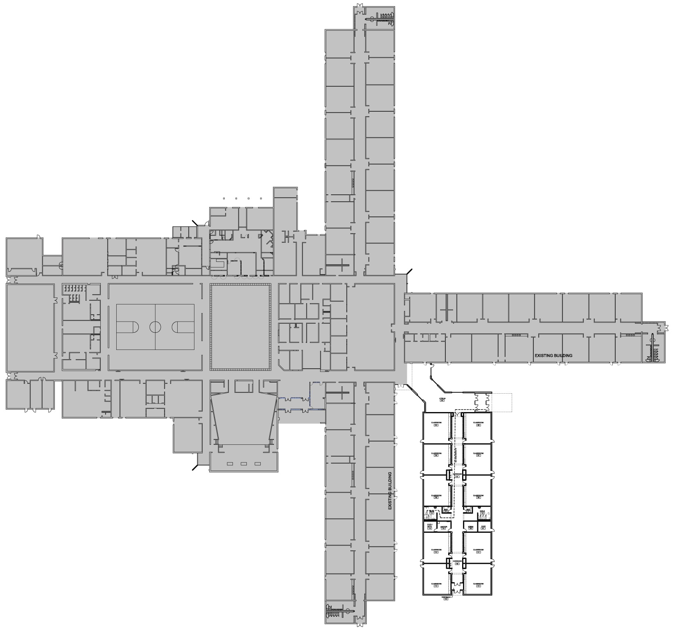
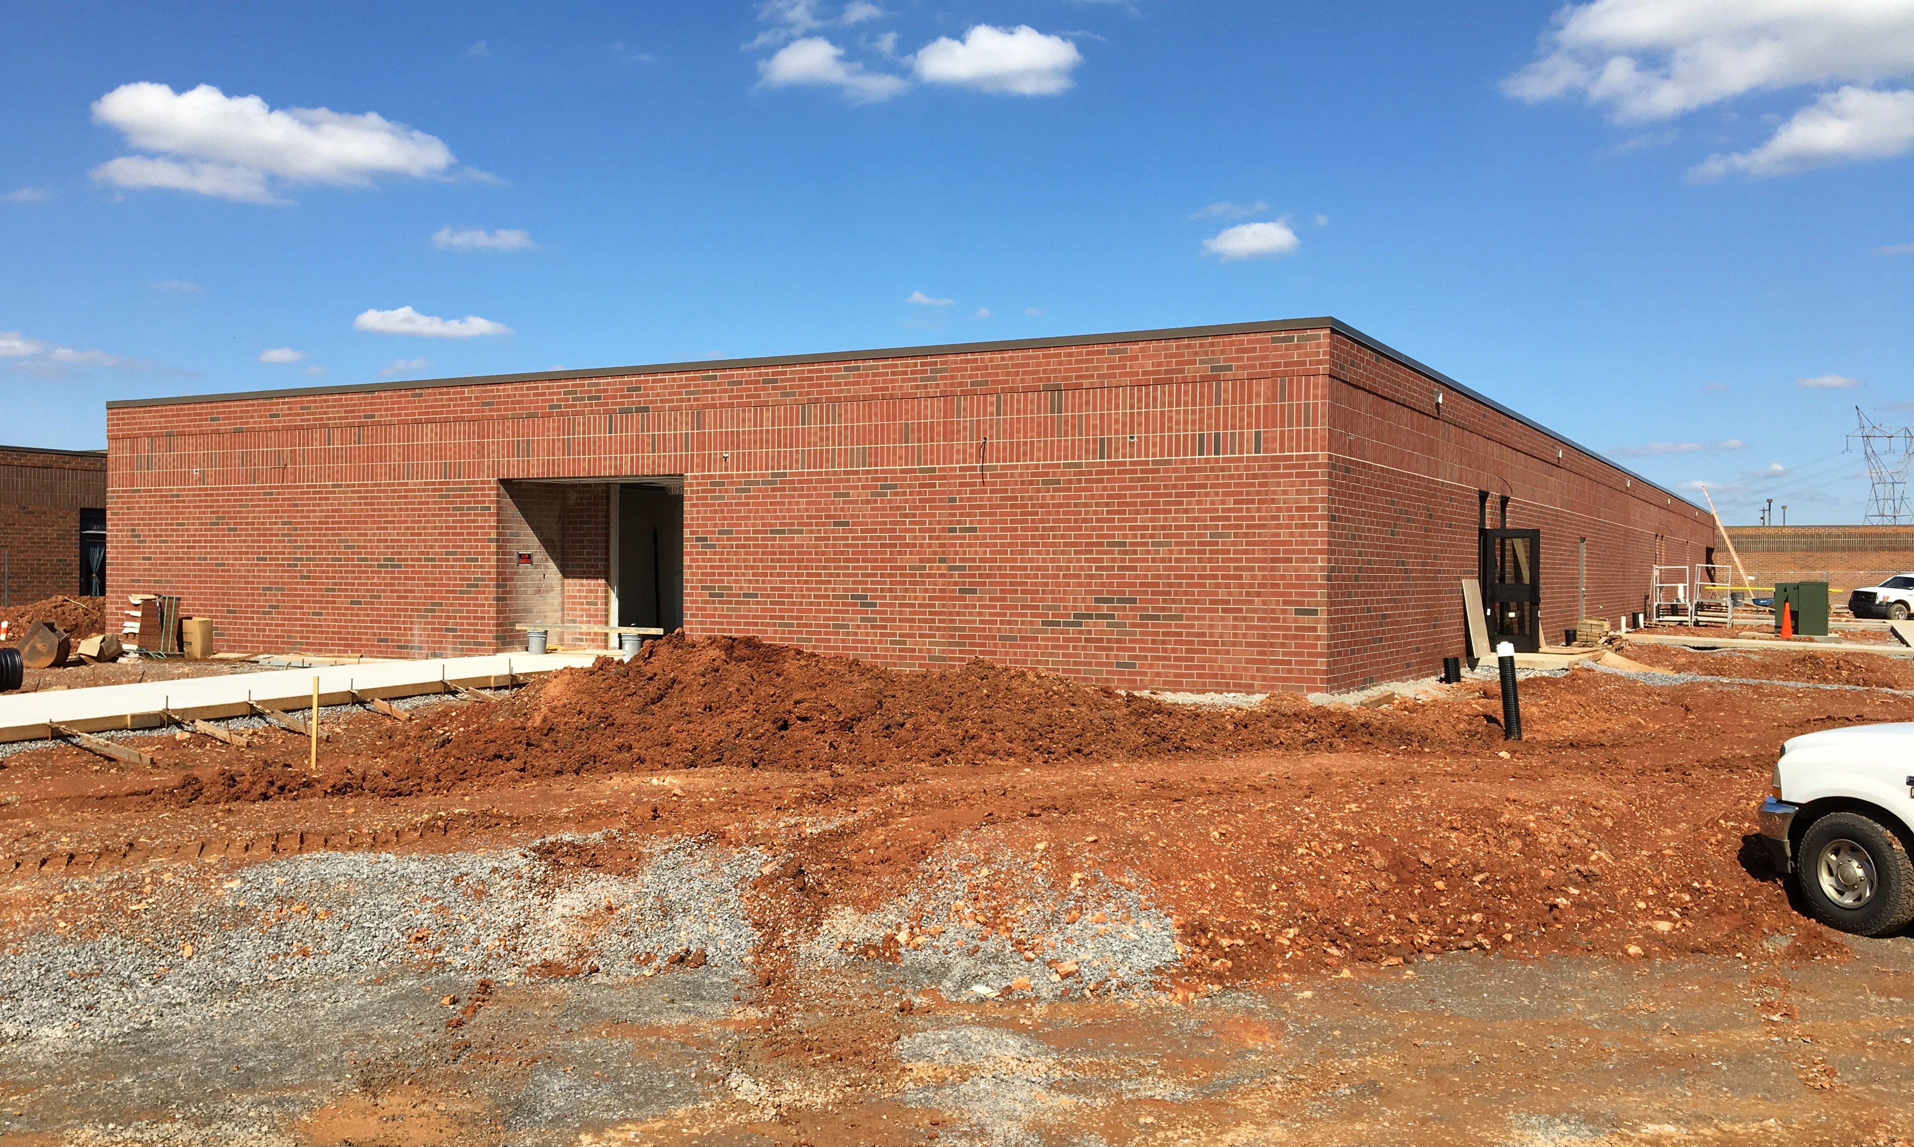
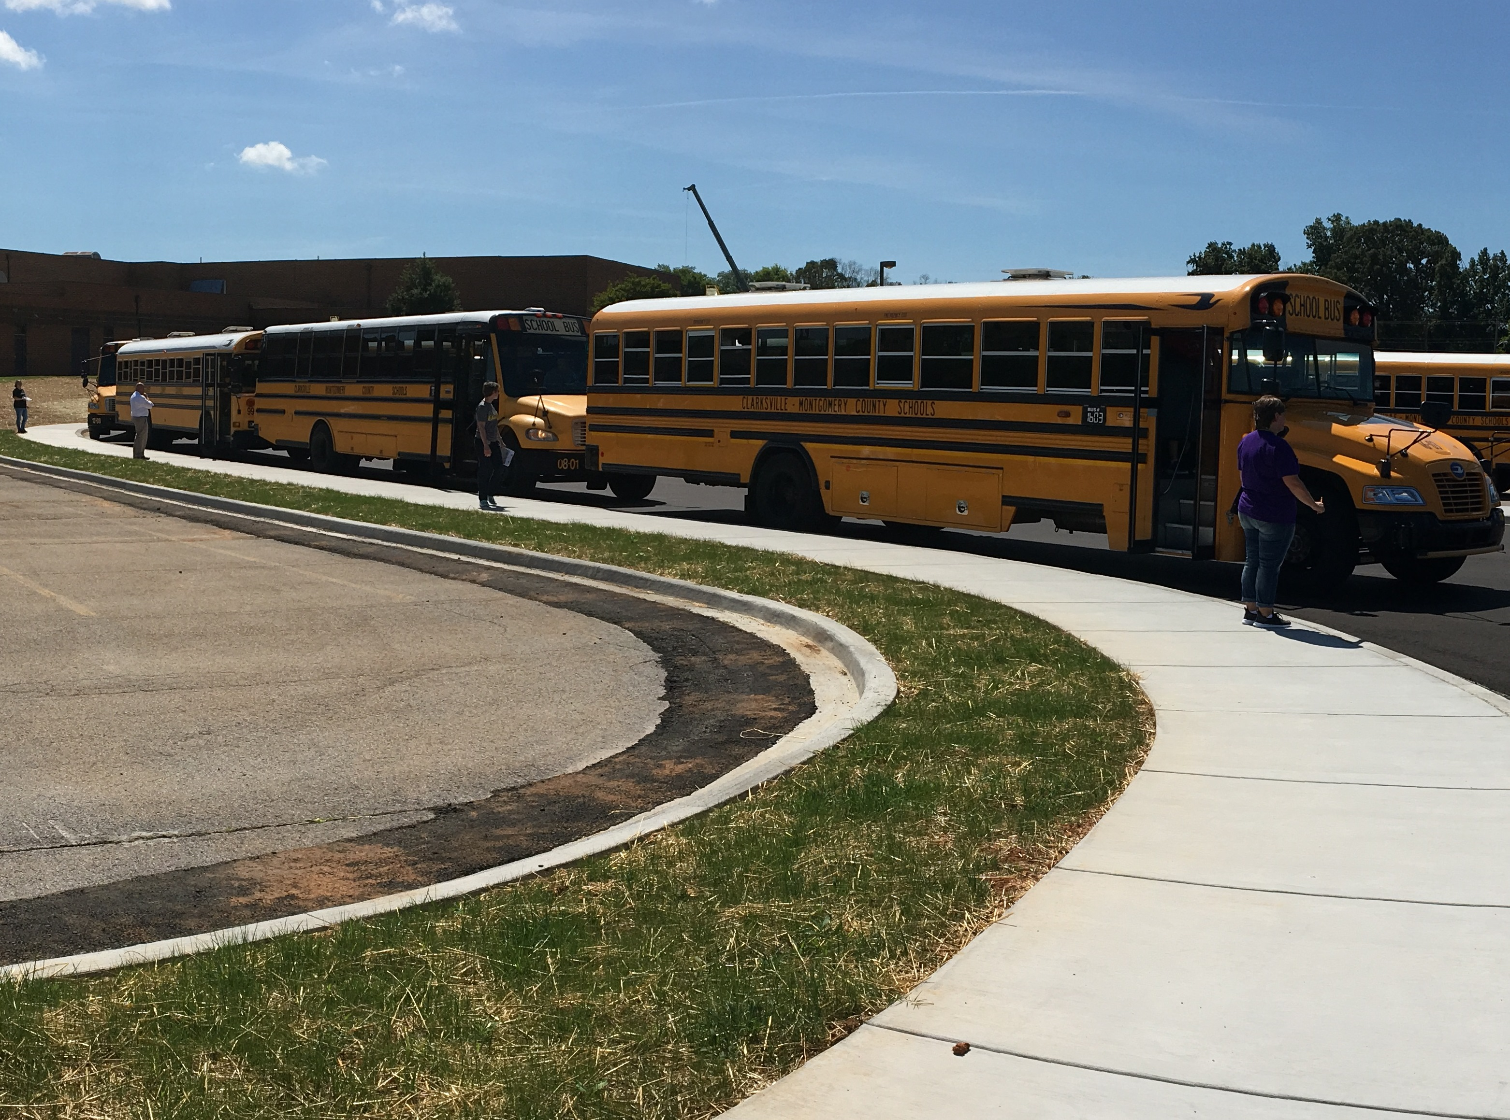
Northeast Middle School
Description:
17,152 Square foot addition with 10 classrooms, two restrooms, mechanical, technology, connector, and transportation site modifications
BEP: 1,096 → 1,285
Financial Summary: | BID
Building Construction | $2,810,317
Equipment/Tech./Furniture/Oth | $200,000
 | $3,010,317

Slide 19
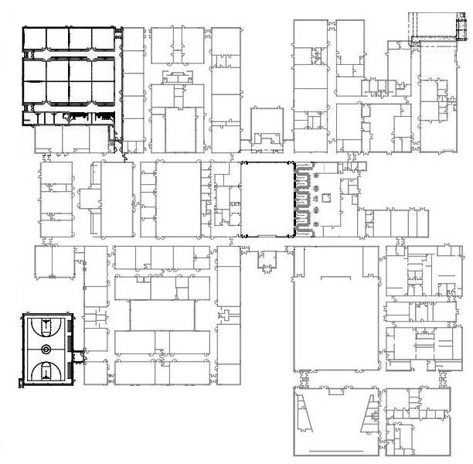
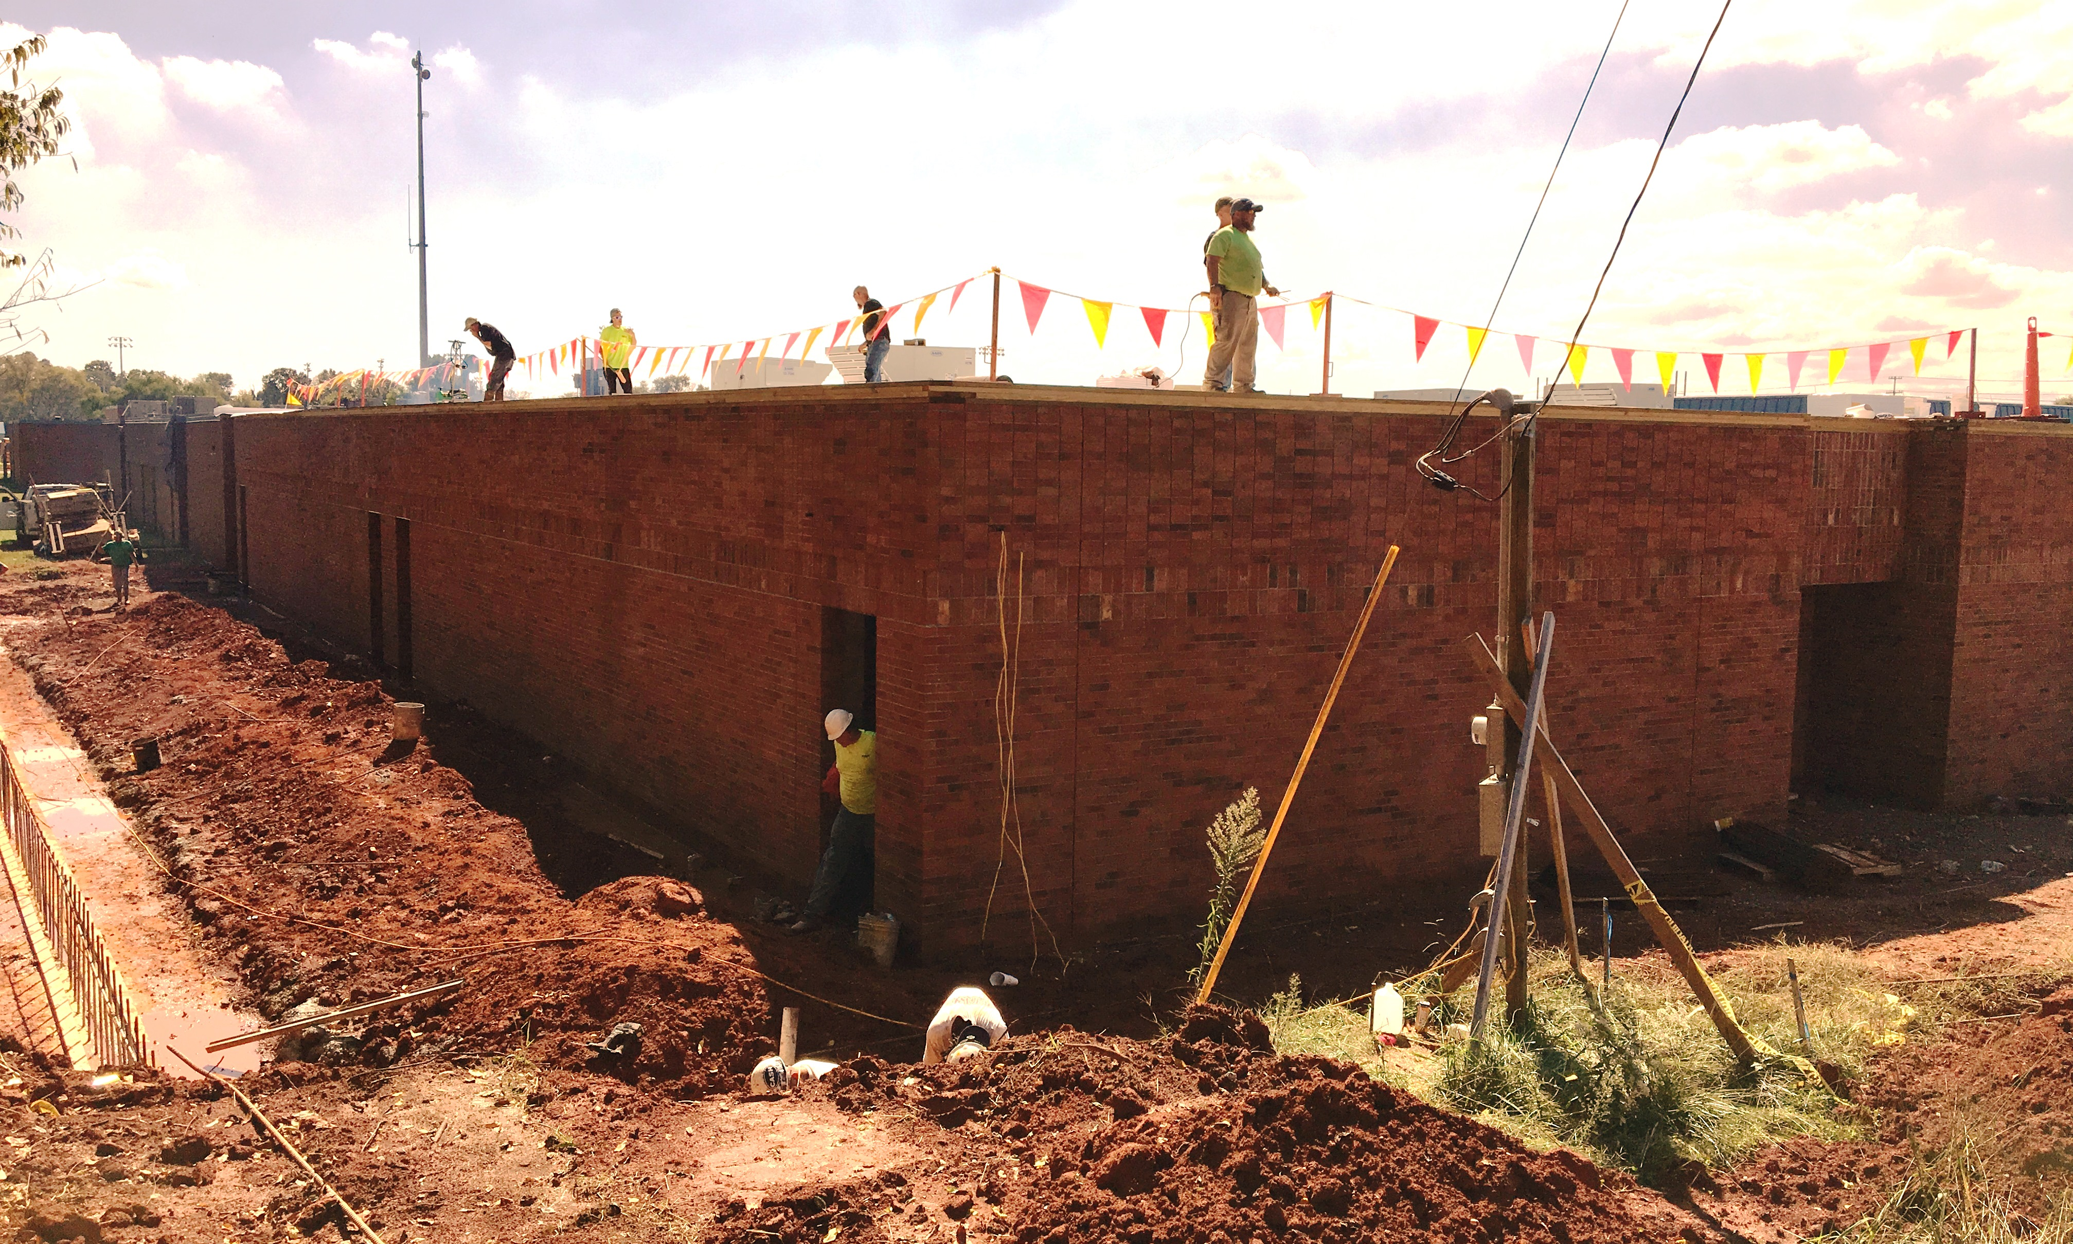
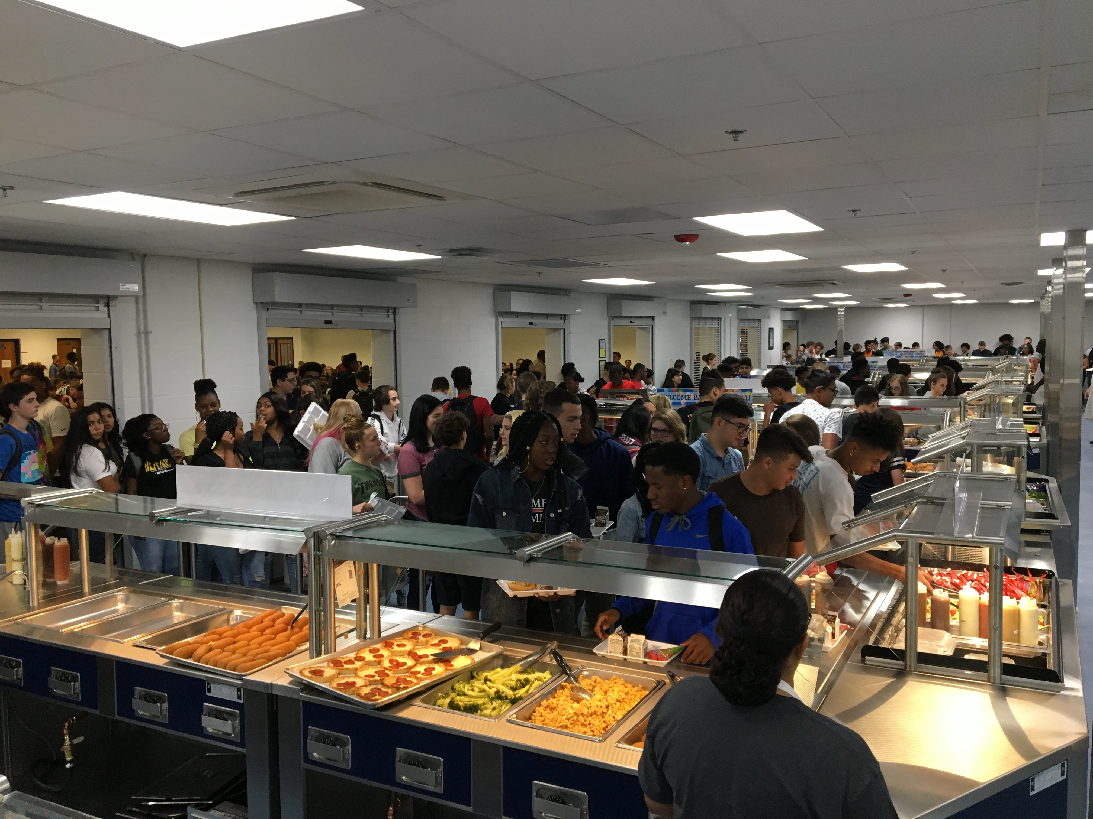
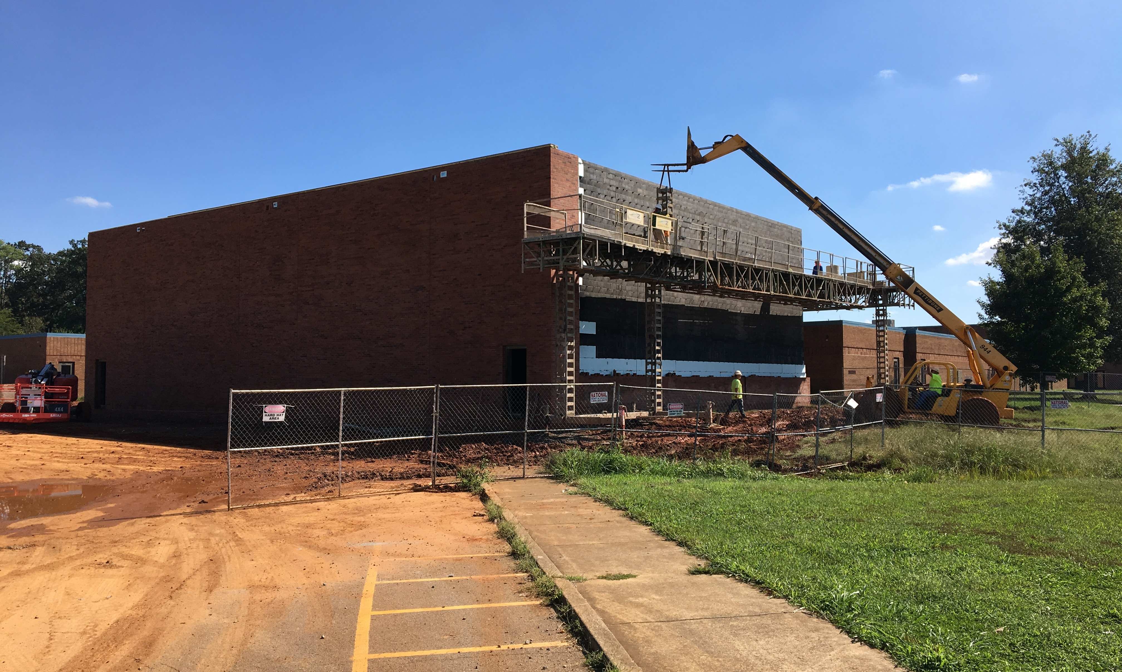
Northeast High School
Description:
24,750 Square foot addition with 12 classrooms, auxiliary gymnasium, two restrooms, offices, mechanical, technology, ADA delivery area, kitchen serving line renovation, and minor site modifications
BEP: 1,470 → 1,705
Financial Summary: | BID
Building Construction | $5,438,762
Equipment/Tech./Furniture/Oth | $200,000
 | $5,638,762

Slide 20
Facilities Planning and Construction Next Steps

Slide 21
2017-2021 Building Program
Phase 2
3 Projects
January 2019
$50.3 Million Total

Slide 22
Building New Capacity
Phase One Projects are nearing completion
Continued overcrowding in zoning regions I & II
More students in middle schools than available capacity.
Staff Recommendation
Seek design approval for two elementary additions and one new middle school to begin in January 2019

Slide 23
Questions?

