Slide 1
2019-2020
Zoning Review: Final Recommendation
January 15, 2019

Slide 2
Middle & High School Capacities
Initial Staff Recommendation:
No change to the Middle and High School Zones for the 2019/2020 School Year
Feedback:
None Received
Final Staff Recommendation :
No change to the Middle and High School Zones for the 2019/2020 school year

Slide 3
Elementary School Capacities
Initial Staff Recommendation:
No change to the Elementary School Zones for the 2019/2020 School Year
Feedback:
Feedback was received regarding the Eagles Bluff Subdivision

Slide 4
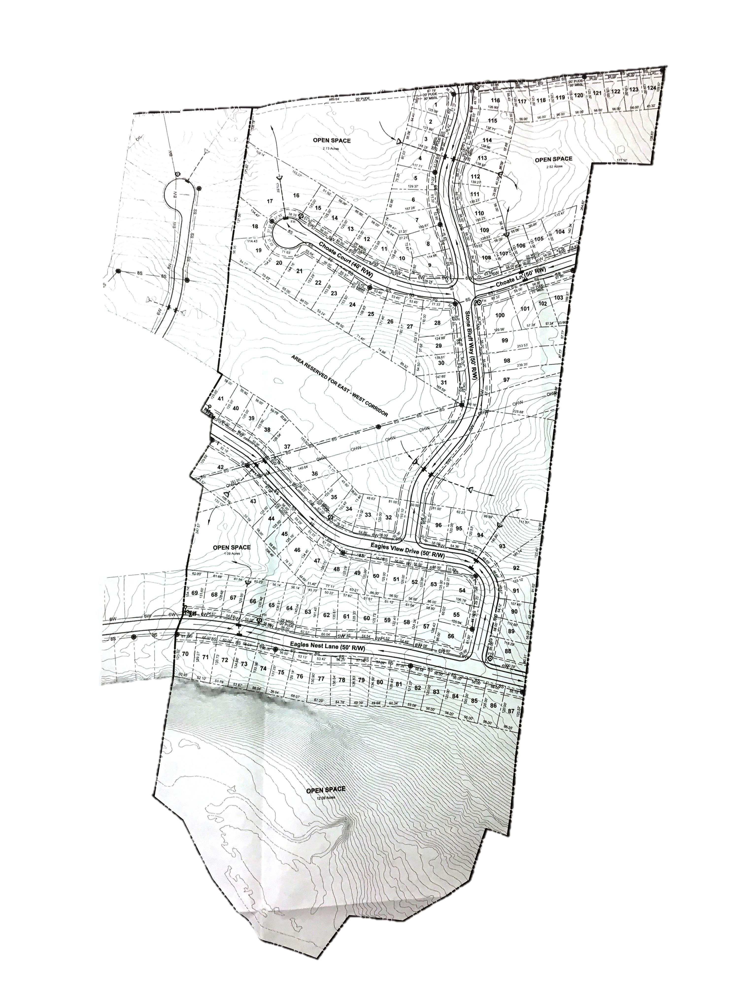
Eagle’s Bluff Subdivision
Northeast
97%/86% (5)
St. Bethlehem/Burt
66%/91%

Slide 5
Elementary School Capacities
Initial Staff Recommendation:
No change to the Elementary School Zones for the 2019/2020 School Year
Feedback:
Feedback was received regarding the Eagles Bluff Subdivision
Final Staff Recommendation :
Northeast Elementary school zone will be changed to include Eagles Bluff Subdivision. In order to accommodate the additional students, a voluntary PreK classroom is being relocated to another school.

