Slide 1
High School 10 point grade scale Work Ethic Distinction

Slide 2
Grading Scale
TN Uniform Grading Scale
93-100 A
85-92 B
75-84 C
70-74 D
69 and below F
Surrounding states
AL, AR, GA, KY, MS, MO, NC, VA
90-100 A
80-89 B
70-79 C
60-69 D
59 and below F

Slide 3
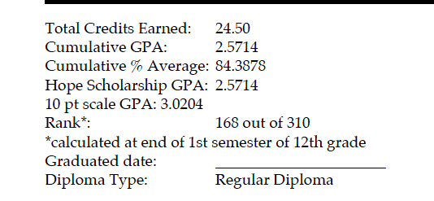
Grading Scale
Scholarship concerns
TN Promise
Once enrolled in post secondary maintain a 2.0 GPA
Hope Scholarship
3.0 GPA
University of Alabama
TN Scale student has a 3.48 GPA $18,000/year.
10-point grading scale student has 3.70 GPA $24,000/year

Slide 4
Work Ethic Distinction
Work Ethic Distinction was developed to address the technical and employability/soft skill needs workforce has identified as critical to success in the world of work.
Students who acquire Work Ethic Distinction are validating that they are both college and career ready.
Students must earn a minimum of 25 points on the Work Ethic Distinction Rubric.
Gold = 35-40 points
Silver = 30-34 points
Bronze = 25-29 points

Slide 5
Work Ethic Distinction

Slide 6
Work Ethic Distinction

Slide 7
Work Ethic Distinction

Slide 8
Work Ethic Distinction

