Slide 1
Standards Based Reporting

Slide 2
The Tennessee State Standards:
establish high and challenging performance towards achieving specific learning goals,
they describe what students should know and be able to do, and
serve as the basis for Clarksville Montgomery County School System’s curriculum, instruction, and assessment model.
Notes:
read slide

Slide 3
What do grades tell us?
Name | Reading | Math | Social Studies | Science
Sally Smith | A | D | C | B
Notes:
When we receive traditional progress reports and report cards, we see a single grade per subject area. This grade reflects an average of the student’s graded work and assessments on standards taught during the nine weeks.

Slide 4
Traditional Grading
Name | Reading | Math | Social Studies | Science
Sally Smith | A | D | C | B
 | 87/B 88/B 93/A 95/A 96/A 99/A = 93/A | 65/F 65/F 73/D 80/C 80/C 85/B = 74/D | 68/F 72/D 75/D 80/C 88/B 95/A = 79/C | 76/D 77/C 84/C 88/B 92/B 95/A = 85/B
Notes:
If you look more closely at graded classwork and assessments, you can see that a student can improve over time but still be penalized for performing poorly on his/her first attempts even though over time the student has improved. With standards based grading students will be scored on their current understanding of standards and not the average of all of their attempts.

Slide 5
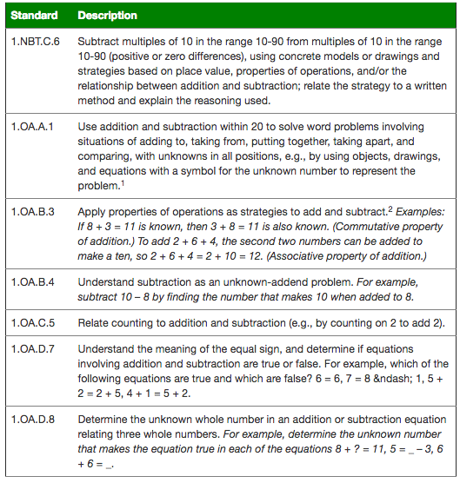
Notes:
For example, these are the standards that are to be covered in the first nine weeks in math. In traditional grading, a student would receive a grade that is created by averaging their performance on all assessments and classwork for all of these standards. This doesn’t tell you what the student did well or where the student continues to need support.

Slide 6
B
Notes:
For example, these are the standards that are to be covered in the first nine weeks in math. In traditional grading, a student would receive a grade that is created by averaging their performance on all assessments and classwork for all of these standards. This doesn’t tell you what the student did well or where the student continues to need support. It gives you an average of all classwork and assessments for all standards taught. Where do you begin to help your child?

Slide 7
How will student mastery be reported to parents?
Mastery will be reported using these terms:
OT – On Track
AE – Approaching Expectations
BE – Below Expectations
Notes:
student progress will be reported using mastery language – this will look much like it did for your child in kindergarten.

Slide 8
Standards Based Grading
Sally Smith | Reading
 | Ask and answer questions about key details in a text.
 | Identify who is telling the story at various points in a text
 | Recognize the distinguishing features of a sentence, such as first work, capitalization, and ending punctuation.
 | Print all upper and lowercase letters.
Notes:
In a standards based grading system, you look at the standards individually. Instead of having one reading score that is an average of all reading assessments and classwork for all standards you have a score for each individual standard. This allows the teacher, student and parent to know where to focus in helping the student meet the grade level expectations.

Slide 9
Standards Based Grading
Sally Smith | Reading
Approaching Expectations | Ask and answer questions about key details in a text.
Approaching Expectations | Identify who is telling the story at various points in a text
Below Expectations | Recognize the distinguishing features of a sentence, such as first work, capitalization, and ending punctuation.
On Track | Print all upper and lowercase letters.
Notes:
Each individual standard will receive a score based on the student’s progress toward meeting the grade level expectation.

Slide 10
Standards are expected to be
mastered over time.
Every lesson is a step toward mastery.
Notes:
read slide
in a standards based reporting model, the teacher is able to look at each standard individually and score student’s based on mastery of the individual standard.

Slide 11
1.OA.A.1 Use addition and subtraction within 20 to solve word problems involving situations of adding to, taking from, putting together, taking apart, and comparing with unknowns in all positions, e.g. by using objects, drawings, and equations with a symbol for the unknown number to represent the problem.
Notes:
let’s look at the complexity of the standards…

Slide 12
1.OA.A.1 Use addition and subtraction within 20 to solve word problems involving situations of adding to, taking from, putting together, taking apart, and comparing with unknowns in all positions, e.g. by using objects, drawings, and equations with a symbol for the unknown number to represent the problem.
Notes:
let’s look at the complexity of the standards…

Slide 13
MASTERY
of standard
DEVELOPING
the standard
Notes:
There are many steps to take before mastering a grade level standard.

Slide 14
MASTERY
of standard
DEVELOPING
the standard
Add within 10
Notes:
Let’s look at the skills and steps for this math standard. Some of these are skills from kindergarten that are needed to develop the standard and some are the new skills required to master the standard.

Slide 15
MASTERY
of standard
Subtract within 10
DEVELOPING
the standard
Add within 10
Notes:
Let’s look at the skills and steps for this math standard. Some of these are skills from kindergarten that are needed to develop the standard and some are the new skills required to master the standard.

Slide 16
MASTERY
of standard
Add and subtract word problems
within 10
Subtract within 10
DEVELOPING
the standard
Add within 10
Notes:
Let’s look at the skills and steps for this math standard. Some of these are skills from kindergarten that are needed to develop the standard and some are the new skills required to master the standard.

Slide 17
MASTERY
of standard
Add within 20
Add and subtract word problems
within 10
Subtract within 10
DEVELOPING
the standard
Add within 10
Notes:
Let’s look at the skills and steps for this math standard. Some of these are skills from kindergarten that are needed to develop the standard and some are the new skills required to master the standard.

Slide 18
MASTERY
of standard
Subtract within 20
Add within 20
Add and subtract word problems
within 10
Subtract within 10
DEVELOPING the standard
Add within 10
Notes:
Let’s look at the skills and steps for this math standard. Some of these are skills from kindergarten that are needed to develop the standard and some are the new skills required to master the standard.

Slide 19
MASTERY
of standard
Add and
subtract word
problems
within 20
Subtract within 20
Add within 20
Add and subtract word problems
within 10
Subtract within 10
DEVELOPING
the standard
Add within 10
Notes:
As students take steps towards mastery of this standard they will be developing their understanding of each skill required. During this time your student will be approaching expectations of the standard. If your child is struggling with a concept, or skill, he/she could be below expectations. Your child’s teacher will score your child On track if the child is meeting the expectations of the standard.

Slide 20
MASTERY
of standard
Add and
subtract word
problems
within 20
Subtract within 20
Add within 20
Add and subtract word problems
within 10
Subtract within 10
Add within 10
Notes:
If students in first grade are still learning their facts within 10 they would be below expectations for this standard because that is a kindergarten skill that should have been developed in the previous grade level.

Slide 21
MASTERY
of standard
Add and
subtract word
problems
within 20
Subtract within 20
Add within 20
Add and subtract word problems
within 10
Subtract within 10
Add within 10
Notes:
If students are learning their facts within 20 they would be approaching expectations because they are moving closer to the application of the facts and that is the expectation of the standard.

Slide 22
MASTERY
of standard
Add and
subtract word problems
within 20
Subtract within 20
Add within 20
Add and subtract word problems
within 10
Subtract within 10
Add within 10
Notes:
If students are applying their facts within 20 in word problems they would be on track because they are meeting the expectation of the standard.

Slide 23
MASTERY
of standard
Add and
subtract word problems
within 20
Subtract within 20
Add within 20
Add and subtract word problems
within 10
Subtract within 10
Add within 10
Notes:
Developing the standard takes time. It will be typical to see approaching expectations during the first semester. As we progress through the school year you will see your students move closer to mastery of standards and be On track. If your child is below expectations you should be working closely with your child’s teacher to develop a plan to support your child academically.

Slide 24
How will student mastery be reported to parents?
Student Work
Progress Reports
Report Cards
Parent Access to PowerSchool
Notes:
there are many ways that progress will be reported throughout the school year.

Slide 25
First Nine Weeks
Reading Standards
Describe characters, settings, and major events in a story, using key details. | AE
Describe the connection between two individuals, events, ideas, or pieces of information in a text. | BE
Distinguish between information provided by pictures or other illustrations and information provided by the words in a text. | AE
Math Standards
Use addition and subtraction within 20 to solve word problems | OT
Solve word problems that call for addition of three whole numbers whose sum is less than or equal to 20. | AE
Determine the unknown whole number in an addition or subtraction equation relating three whole numbers. | BE
Notes:
Progress reports and report cards will share information with parents about where students are in relationship to the standards at that point in time. This is an example of a progress report or report card in the first nine weeks. Notice that most of the standards are below or approaching expectations. It is possible to have some on track standards at this point in the year as well. It will be important to reference student work and assessments to help you know what each of the standards mean. This will help you better understand how to support your child at home. Many teachers also put information about the standards in newsletters and classroom communication.

Slide 26
Third Nine Weeks
Reading Standards
Describe characters, settings, and major events in a story, using key details. | OT
Describe the connection between two individuals, events, ideas, or pieces of information in a text. | AE
Distinguish between information provided by pictures or other illustrations and information provided by the words in a text. | OT
Math Standards
Use addition and subtraction within 20 to solve word problems | OT
Solve word problems that call for addition of three whole numbers whose sum is less than or equal to 20. | OT
Determine the unknown whole number in an addition or subtraction equation relating three whole numbers. | AE
Notes:
As students have more opportunity to practice the standards over the course of the school year you would expect to see the mastery indicators improve. By the third nine weeks, students who are meeting grade level expectations should be on track with most, if not all, standards with few to no standards being marked below expectations.

Slide 27
How will student mastery be reported to parents?
Student Work
Progress Reports
Report Cards
Parent Access to PowerSchool
Notes:
parents can also access reports in powerschool.

Slide 28
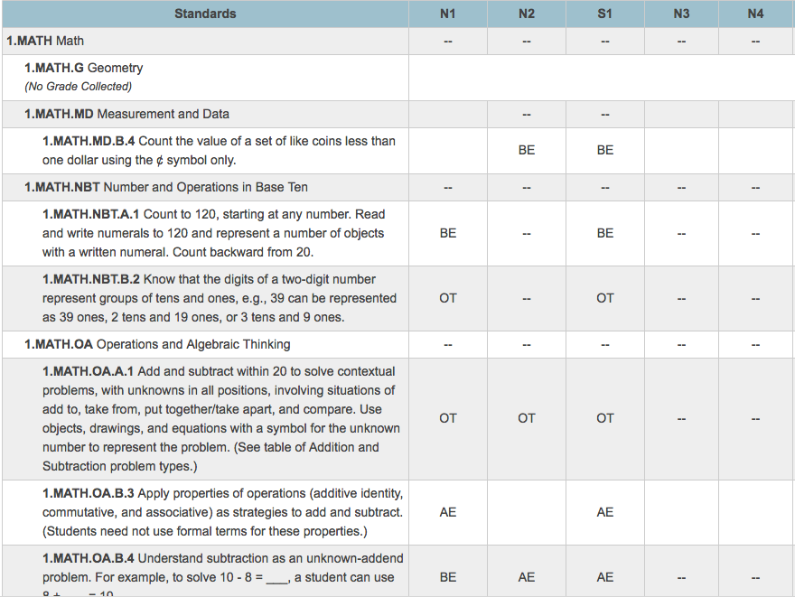
Exploring student progress on PowerSchool

Slide 29
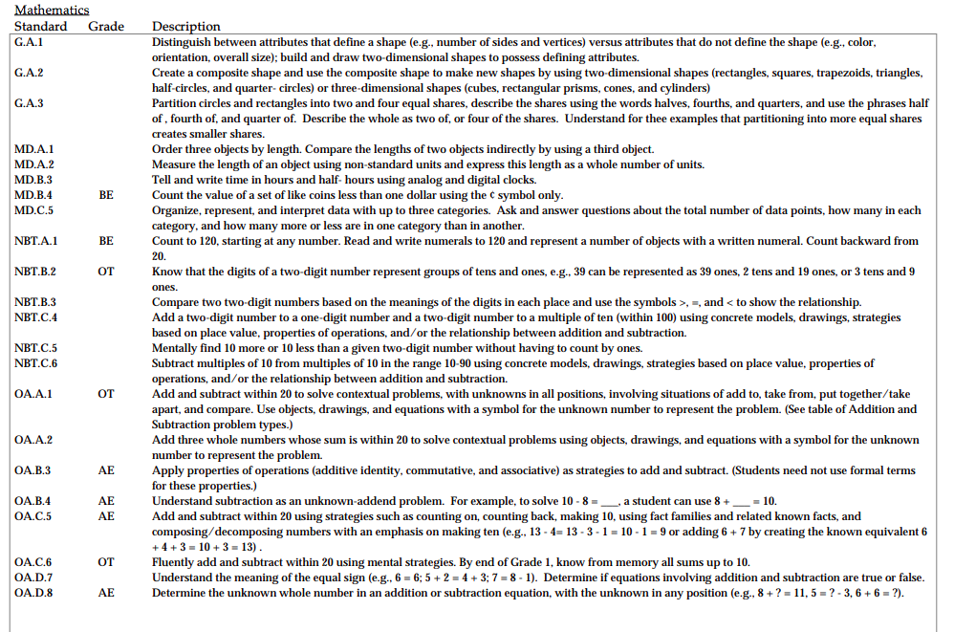
Standards Based Report Card

Slide 30
Standards are expected to be
mastered over time.
Every lesson is a step toward mastery.
Notes:
remember, standards are expected to be mastered over time.

Slide 31
Developing a Growth Mindset
Notes:
You may have heard the term growth mindset. It is the belief that we can get smarter over time with practice and perseverance. Standards based reporting supports developing growth mindset in students because they can see their progress over time. They can see how their effort toward meeting their learning goals will equal higher achievement.
***point out steps to high achievement on the graphic and connect to SBRC
this is a great article to print and give to parents to take home - https://learningchildblog.com/2017/01/05/growth-mindset-in-early-learners/

Slide 32
Standards Based Reporting

Slide 33
Thank You!
For more information you may contact:
Your child’s teacher
Your school’s academic coach
Your school’s administrator
Notes:
I hope this presentation has been helpful in understanding how your child’s progress will be reported this school year. For additional information or support, please contact…

